Slide 1

Odds and Probability
Presented by:
Elizer Ponio Jr.
Department of Computer Science
College of Computing and Information Technologies

Slide 2
Outline
Introduction
Odds and Probability
Log Odds
Logit Function

Slide 3
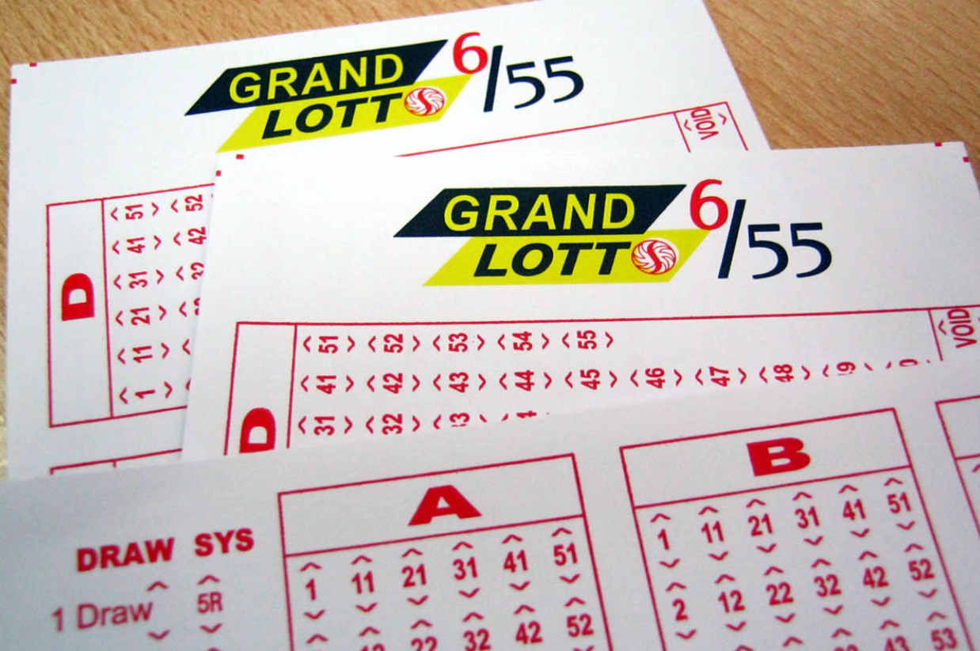
Have you ever tried to place a bet in the lottery?

Slide 4
Grand Lotto 6/55 is a lottery system wherein the player bets on 6 different numbers from number 1 to 55.

Slide 5
How to play the game:
You pick 6 numbers from 1 to 55.
Each number must be unique; you cannot pick a number twice.
Your 6-number combination does not require any order.

Slide 6
How do you win?
If your 6 numbers matched the 6 winning numbers that were drawn, you win the jackpot prize.
You win a consolation prize if you matched only 3, 4 or 5 numbers.

Slide 7
How Many Combinations Can Be Formed with 55 Numbers?
You can form 28,989,675 combinations from numbers 1 to 55 wherein each combination comprises 6 unique non-repeating numbers in no particular order.

Slide 8
What's The Odds of Winning Lotto 6/55?
Based on 28,989,675 combinations, your odds of winning a lottery 6/55 is 0.0000034% or 1:28,989,675.
You have to play 289,896 combinations to increase your odds of winning to 1%.

Slide 9
What's The Odds of Winning Lotto 6/55?
If you are going to play all the 28 million plus combinations, it will cost you ₱695,752,200.

Slide 10
What's The Odds of Winning Lotto 6/55?
You will have to wait for the jackpot prize to reach ₱878,475,000 just to breakeven (that is after deducting the 1% agent's commission and the 20% tax on winnings).

Slide 11
What's The Odds of Winning Lotto 6/55?
On the other hand, playing 289,896 combinations will cost you ₱6,957,504.

Slide 12
Odds and Probability
Sometimes, you might hear someone say that
“The odds are against you!”
“The odds are in favor of you!”
“What are the odds?”
“The odds in favor of me winning the game are 1 to 4”

Slide 13
Odds and Probability
Sometimes, you might hear someone say that
“The odds are against you!“

Slide 14
Odds and Probability
Sometimes, you might hear someone say that
“The odds are in favor of you!”

Slide 15
Odds and Probability
Sometimes, you might hear someone say that
“What are the odds?”

Slide 16
Odds and Probability
Sometimes, you might hear someone say that
“The odds in favor of me winning the game are 1 to 4”

Slide 17
Odds and Probability
“The odds in favor of me winning the game are 1 to 4”

Slide 18
Odds and Probability
Visually, we have 5 games in total

Slide 19
Odds and Probability
One of which I will win! ☺

Slide 20
Odds and Probability
and four of which I will lose ☹

Slide 21
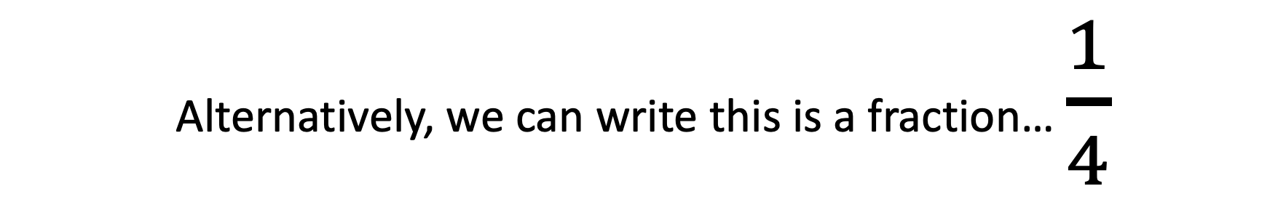
Odds and Probability
Alternatively, we can write this is a fraction… $\frac{1}{4}$

Slide 22
Odds and Probability
Visually, we have 1 game that we win and 4 games that we lose

Slide 23
Odds and Probability
If we do the math, we see that the odds are 0.25 that we will win the game

Slide 24
Odds and Probability
Note: Odds are not probabilities!

Slide 25
Odds and Probability
The odds are the ratio of something happening (i.e. me winning a game)
To something not happening (i.e. me losing a game)

Slide 26
Odds and Probability
Probability is the ratio of something happening (i.e. me winning a game)
To everything that could happen (i.e. me winning and losing a game)

Slide 27
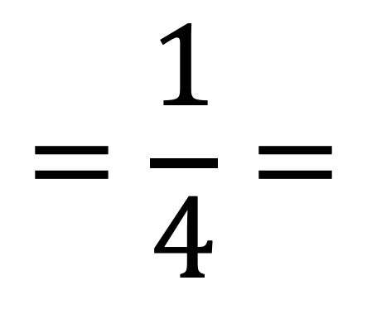
Odds and Probability
$$=\frac{1}{4}=$$
0.25
In the previous example, the odds in favor of me winning are 1 to 4…

Slide 28
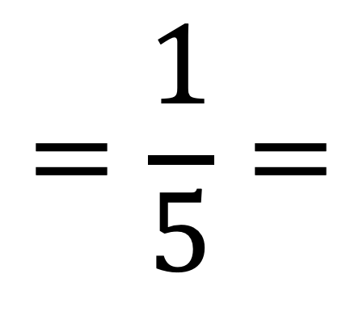
Odds and Probability
$$=\frac{1}{5}=$$
0.2
The probability of me winning is the number of games I win divided by the total number of games I play

Slide 29
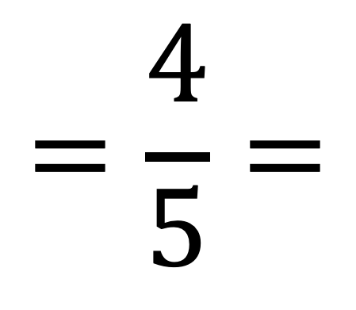
Odds and Probability
$$=\frac{4}{5}=$$
0.8
We can also calculate the probability of losing

Slide 30
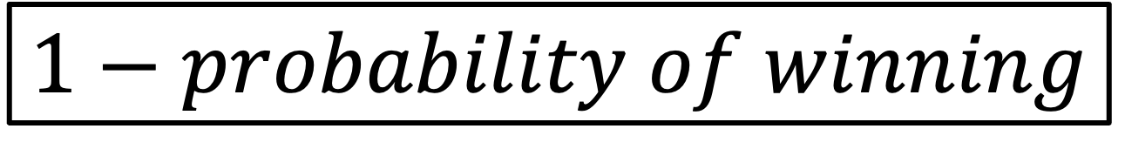
Odds and Probability
$$1−probability of winning$$
We can also calculate the probability of losing using this simple formula

Slide 31
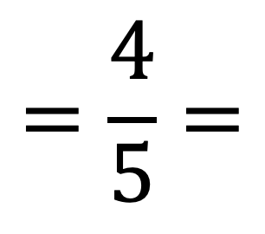
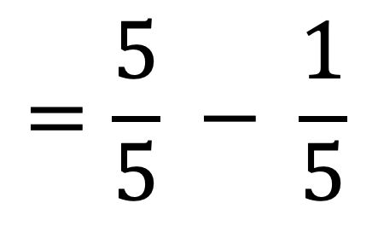
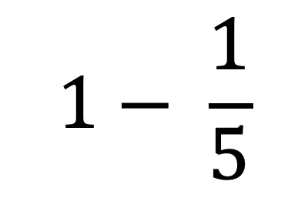
Odds and Probability
$$1− \frac{1}{5}$$
$$=\frac{5}{5} − \frac{1}{5}$$
$$=\frac{4}{5}=$$
0.8

Slide 32
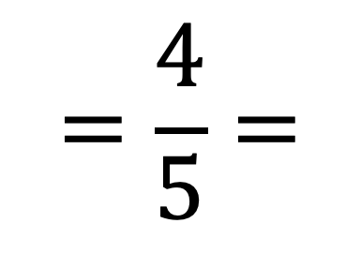
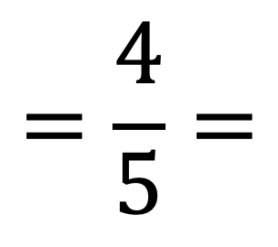
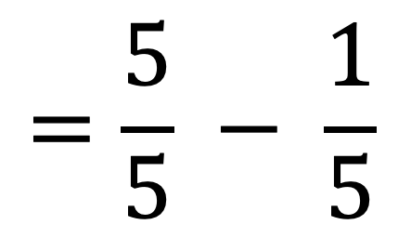
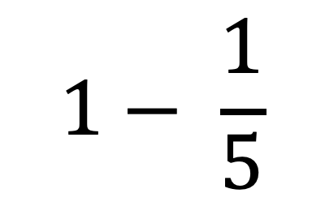
Odds and Probability
$$=\frac{4}{5}=$$
0.8
$$1− \frac{1}{5}$$
$$=\frac{5}{5} − \frac{1}{5}$$
$$=\frac{4}{5}=$$
0.8

Slide 33
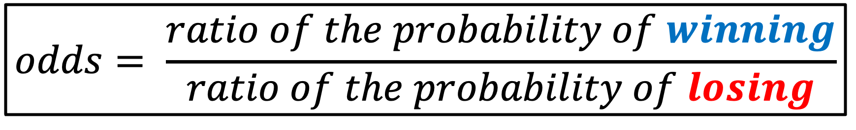
Odds and Probability
$$odds= \frac{ratio of the probability of winning}{ratio of the probability of losing}$$

Slide 34
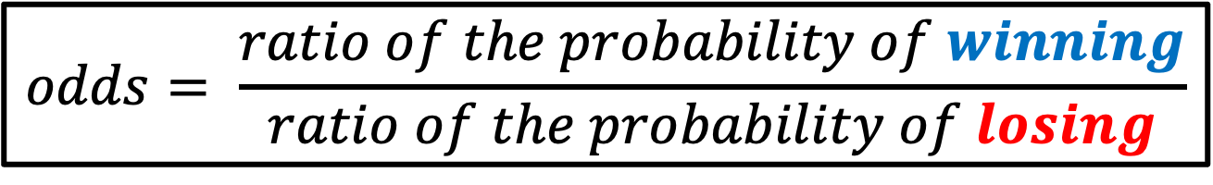
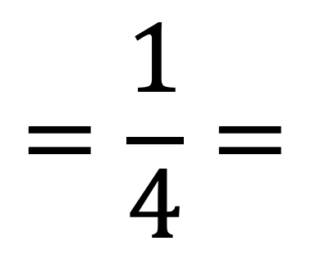
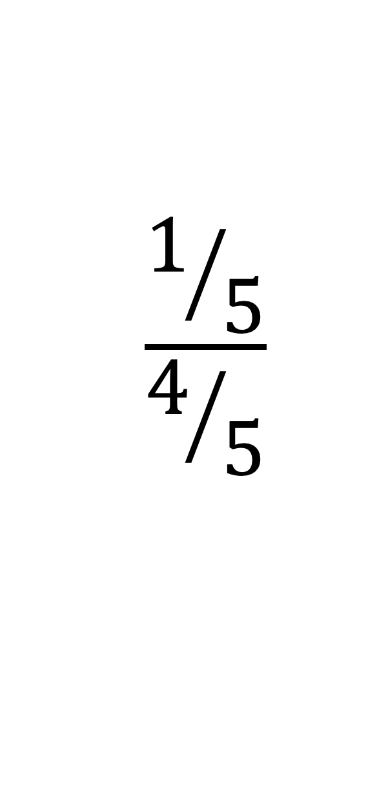
Odds and Probability
$$odds= \frac{ratio of the probability of winning}{ratio of the probability of losing}$$
$$\frac{1/5}{4/5}$$
$$=\frac{1}{4}=$$
0.25

Slide 35
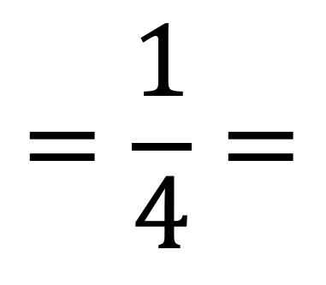
Odds and Probability
$$\frac{1/5}{4/5}$$
$$=\frac{1}{4}=$$
0.25

Slide 36
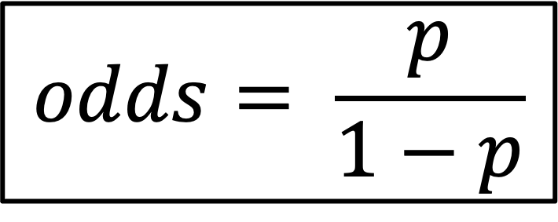
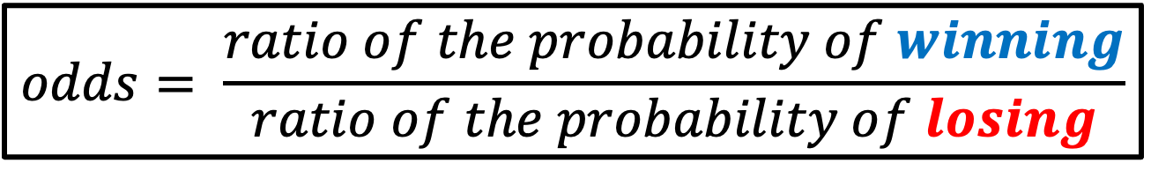
Odds and Probability
$$odds= \frac{ratio of the probability of winning}{ratio of the probability of losing}$$
In statistics, this formula is simplified as…
$$odds= \frac{p}{1−p}$$

Slide 37

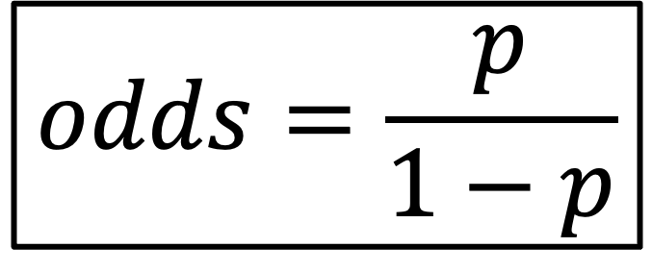
Odds and Probability
$$odds=\frac{p}{1−p}$$
Where $p$ is the probability of winning

Slide 38
Log odds
$$=\frac{1}{4}=$$
0.25

Slide 39
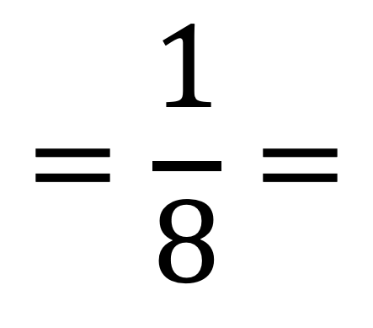
Log odds
$$=\frac{1}{8}=$$
0.125

Slide 40
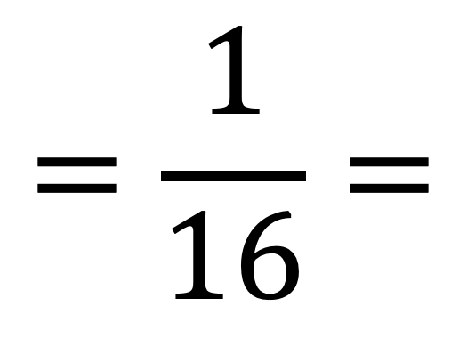
Log odds
$$=\frac{1}{16}=$$
0.062

Slide 41
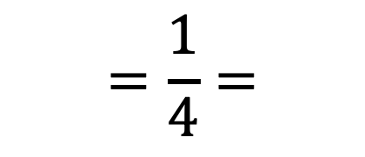
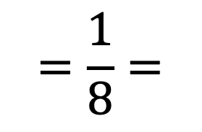
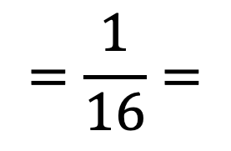
Log odds
$$=\frac{1}{4}=$$
0.25
$$=\frac{1}{8}=$$
We can see that the more games we lose, the odds of winning get closer and closer to 0
0.125
$$=\frac{1}{16}=$$
0.062

Slide 42
Log odds
$$=\frac{1}{4}=$$
0.25
$$=\frac{1}{8}=$$
In other words, if the odds are against me winning, then they will be between 0 and 1.
0.125
$$=\frac{1}{16}=$$
0.062

Slide 43
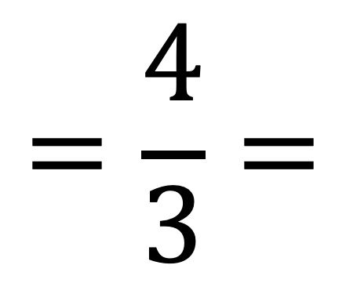
Log odds
$$=\frac{4}{3}=$$
1.3

Slide 44
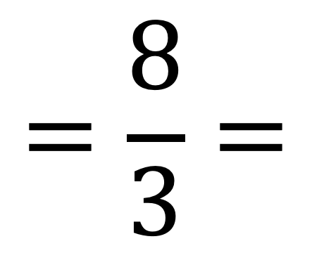
Log odds
$$=\frac{8}{3}=$$
2.7

Slide 45
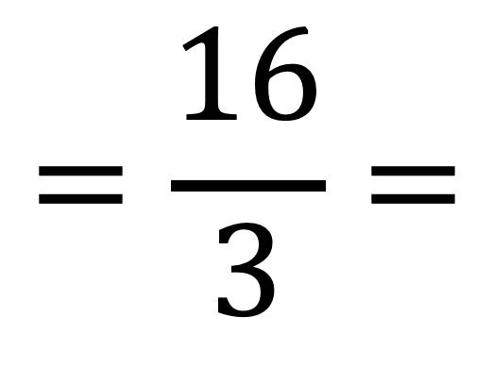
Log odds
$$=\frac{16}{3}=$$
5.33

Slide 46
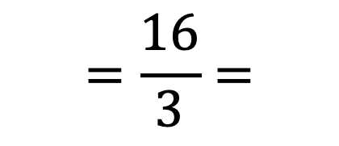
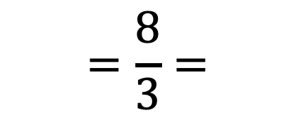
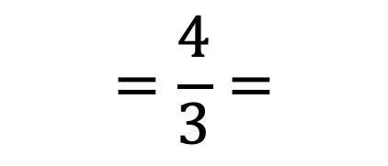
Log odds
$$=\frac{4}{3}=$$
1.3
We can see that the more games I win, the odds of winning starts at 1 ang goes up and up.
$$=\frac{8}{3}=$$
2.7
$$=\frac{16}{3}=$$
5.33

Slide 47
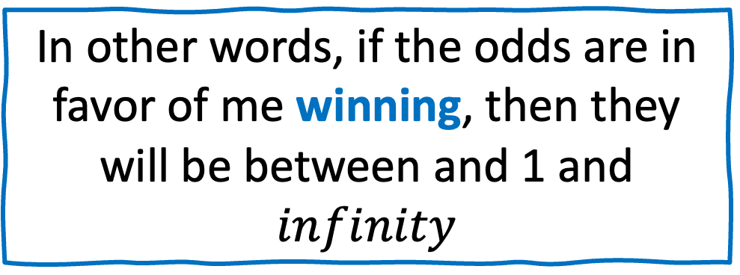
Log odds
$$=\frac{4}{3}=$$
1.3
In other words, if the odds are in favor of me winning, then they will be between and 1 and $infinity$
$$=\frac{8}{3}=$$
2.7
$$=\frac{16}{3}=$$
5.33

Slide 48
Log odds
Odds of me losing goes from 0 to 1
Odds of me winning go from 1 to infinity
0
1
2
3
4
5
6
If we use a number line to see the odds when in favor and against

Slide 49
Log odds
The asymmetry makes it difficult to compare the odds in favor or against me winning
0
1
2
3
4
5
6

Slide 50
Log odds
For example, if the odds are against 1 to 6, then the odds are 1/6 = 0.17
But if the odds are in favor 6 to 1, then the odds are 6/1 = 6
0
1
2
3
4
5
6

Slide 51
Log odds
Taking the log() of the odds solves this problem by making everything asymmetrical.
0
1
2
3
4
5
6

Slide 52
Log odds
For example, if the odds are against 1 to 6, then the log(odds) are log(1/6) = log (0.17) = -1.79
If the odds are in favor 6 to 1, then the log(odds) are log(6/1) = log (6) = 1.79
-3
-2
-1
0
1
2
3

Slide 53
Log odds
Using the log function, the distance from the origin (or 0) is the same for 1 to 6 or 6 to 1 odds
-3
-2
-1
0
1
2
3

Slide 54
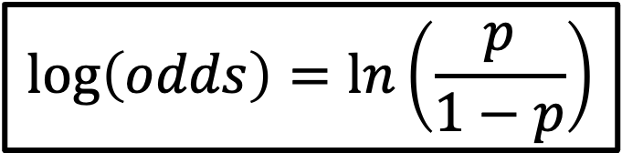
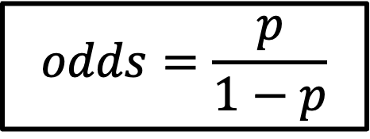
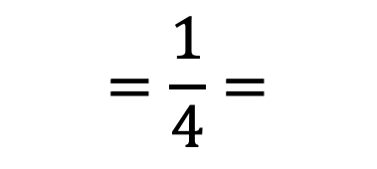
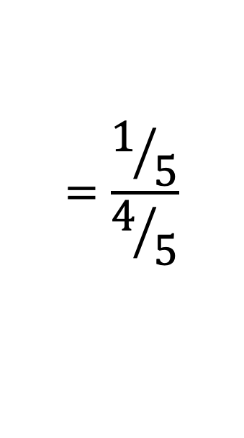
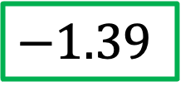
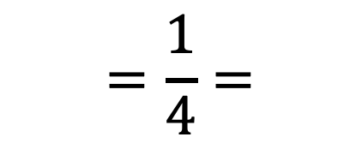

Log odds
$$=\frac{1}{4}=$$
0.25
$$=\frac{1/5}{4/5}$$
$$odds=\frac{p}{1−p}$$
$$=\frac{1}{4}=$$
0.25
$$\log\left(odds\right)=\ln\left(\frac{p}{1−p}\right)$$
$$=\ln\left(0.25\right)=$$
$$−1.39$$

Slide 55
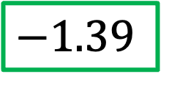

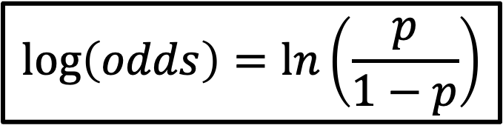
Log odds
$$\log\left(odds\right)=\ln\left(\frac{p}{1−p}\right)$$
$$=\ln\left(0.25\right)=$$
$$−1.39$$
The log of the ratio of the probabilities is called the logit function and forms the basis of
logistic regression!

Slide 56
Summary
The probability that an event will occur is the fraction of times you expect to see that event in many trials. Probabilities always range between 0 and 1.
The odds are defined as the probability that the event will occur divided by the probability that the event will not occur.
Using log of the odds makes the value of being in favor or against symmetrical.

Slide 57
Summary
The logit function forms the basis of logistic regression.

Slide 58
References
https://www.youtube.com/watch?v=ARfXDSkQf1Y
https://www.youtube.com/watch?v=yIYKR4sgzI8&list=PLblh5JKOoLUKxzEP5HA2d-Li7IJkHfXSe&index=1
https://lottotips888.blogspot.com/p/grand-lotto-655.html

